Slide 1

Customer Shopping Trends
Predictive Analytics & Behavior Modeling for Indian E-Commerce
Course: Data Analytics Laboratory
Summer 2026
Md Mainul Islam
0152430008
Sec : BB

Slide 2



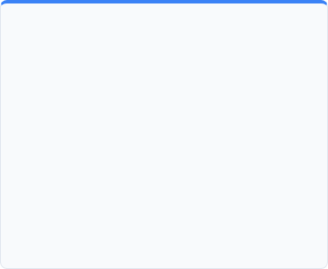
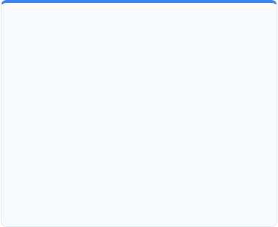
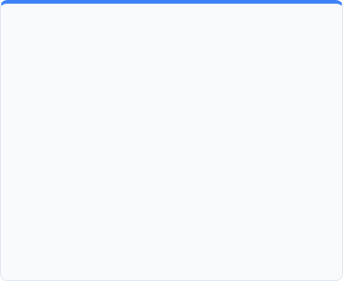
Business Problem & Domain Selection
Domain Selection
Business Problem
Expected Business Value
Indian Omnichannel Retail & E-Commerce
Logistics & Return Bottlenecks
Revenue & Value Optimization
Consumer buying behavior
Regional platform preferences (Amazon, Flipkart, Myntra)
Promotional sale event dynamics.
High return rates
Delivery delays impairing ratings
Ineffective discount allocation during sales.
Predict return risks
Optimize logistics timelines
Personalize promotions
Customer segmentation.

Slide 3
Dataset Specification
Criteria | Required Benchmark | Our Dataset Specification | Compliance Status
Data Source | Verifiable Repository | Kaggle (https://www.kaggle.com/datasets/rewantbhriguvanshi/customer-shopping-trends-indian) | Verified
Row Count | Minimum 2,000 Rows | 10000 Synthetic Transactions (Jan 2023 - Dec 2024) | Compliant
Feature Count | Minimum 25 Features | 26 Features (Demographics, Logistics, Payments, Ratings) | Compliant
Key Attributes | Multi-domain metrics | Transaction ID, Age, Gender, Brand, Amount(₹), Shipping Time, Return Status | High Diversity
Data Quality | Clean & Realistic | Relational logic enforced (e.g., Same-day = 0 days, brand-category locks) | Verified Integrity

Slide 4
Quality Check
Feature Column | Raw Missing Rows | Missing % | Root Cause / Logical Context
Online Store | 2,249 | 22.49% | In-Store Purchases: Offline transactions naturally have no online platform.
Size | 1,035 | 10.35% | Non-Sized Products: Electronics, Groceries, and Accessories do not have sizes.
Festival/Sale | 6,788 | 67.88% | Regular Days: Transactions occurred on non-promotional/standard sales days.
Delivery Speed | 2,249 | 22.49% | In-Store Purchases: Physical store purchases do not involve delivery.
Others | 0 | 0% | Synthetic Dataset

Slide 5

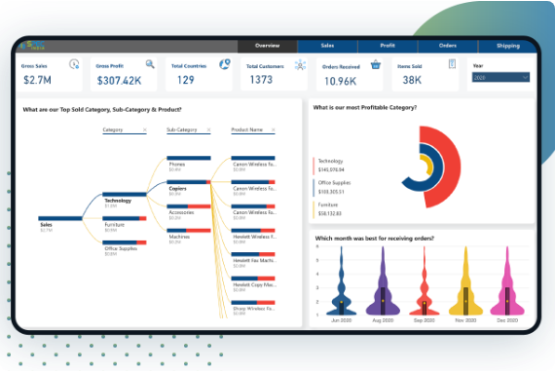
Preprocessing & EDA Strategy
Planned Preprocessing:
Standardization of numerical values (`Purchase Amount`, `Discount %`)
One-Hot Encoding for categorical cities and stores
Ordinal scaling for customer size choices.
EDA Objectives:
Analyze festive vs. standard sales volume (e.g., Big Billion Days spikes)
Evaluate channel share (e.g., Online vs Offline)
Map spending across age brackets.
Core Hypotheses:
1. Delivery times over 3 days lead to lower review ratings and higher return rates. 2. Festival sales yield higher purchase values but suffer increased return rates.

Slide 6
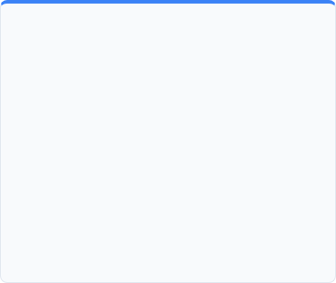

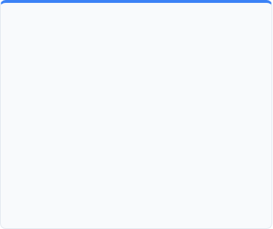



Feature Selection & Modeling Strategy
Feature Selection
ML & DL Pipeline
AI Agent Strategy
Mutual Information Gain
XGBoost
Feature importance ranking.
Planned 4 Candidate Models:
Return Risk & Discount Advisor Agent
•
XGBoost Classifier
Automated agent predicting transaction return risk prior to dispatch and suggesting personalized discount rates to boost retention.
•
Random Forest Classifier
Baseline vs Reduced: Benchmarking model performance using All 26 Features vs. Top 10 Features.
•
Logistic Regression
•
LightGBM / MLP Network

Slide 7
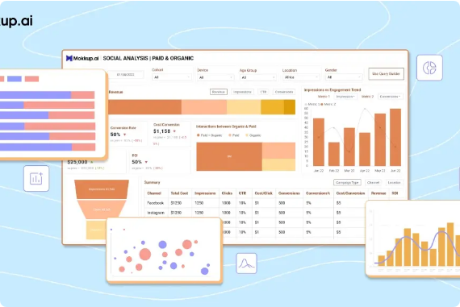
Interactive Dashboard & Deliverables Plan
Framework Choice: ReTool & PowerBI/Tableau interactive web application.
Wireframe Layout:
3-tier design featuring KPI Metric Cards, Interactive EDA Drill-downs, and an AI Agent Prediction Portal.

Slide 8
Thank You!
Questions & Discussion
Data Analytics Laboratory • Summer 2026 United International University (UIU)

Slide 9


Image Sources
https://www.spec-india.com/wp-content/uploads/2022/09/Banner-Retail-Dashboard-In-Power-BI.png
Source: www.spec-india.com
https://mokkupai.s3.ap-south-1.amazonaws.com/files/assets/blogs/cover-images/193.png
Source: www.mokkup.ai

